Slide 1

Final Presentation on Project on
SMART WHEELCHAIR FOR PARALYZED
Presented by
KNR18EE024 JASIRA T P
KNR18EE034 NAYANA RAMESHAN
KNR18EE046 SHRAVAN SREEDEEP
KNR18EE048 SOORYA P
under the guidance of
Dr. C SREEKUMAR
DEPARTMENT OF ELECTRICAL & ELECTRONICS ENGINEERING
GOVT. COLLEGE OF ENGINEERING KANNUR- 670563
June 2022

Slide 2
OVERVIEW
Introduction Objectives Literature Review Schematic Diagram Smart Wheelchair Wheelchair Design Eye Tracking Algorithm Home Automation System Simulation of Wheelchair | Eye Tracking Working Model Working of Wheelchair Estimation of Components Limitations Future Scopes Conclusion Reference

Slide 3
INTRODUCTION
Paralyzed stroke patients are unable to normally communicate with their environment.
Part of their body that is under their control is their eyeballs.
Basic day to day operations are switching on basic devices like fan, bulb etc.
Smart Wheel Chair is the solution that we are proposing for these problems.

Slide 4
OBJECTIVES
To control the electric wheel chair by tracking eye movements.
To design and implement an electric wheelchair.
To track eye movement and control basic devices like bulb, fan etc.

Slide 5
LITERATURE REVIEW
[1] Diksha Raj, Anish Kalra, Sreejith Krishna N, Suhriday Roy, Dr. Shreenath K N, “Wagon - The Smart Wheelchair”, International Journal of Emarging Technologies and Innovative Research , vol.8, 2021
It comprises a wheelchair that works on hand gestures, voice command inputs, app inputs(Keypad), and head movements input for locomotion of the differently abled persons
Project can be upgraded in terms of speed and the lag can be overcome by replacing them with more advanced tools and sensors.

Slide 6
LITERATURE REVIEW
[2] Tan Kian Hou, Yagasena and Chelladurai, “Arduino based voice controlled wheelchair”, First International Conference on Emerging Electrical Energy, Electronics and Computing Technologies, vol. 1432, 2019
Smart motorized voice controlled wheelchair.
Voice command controls the movements of the wheelchair.
Microcontroller used is Arduino Uno.

Slide 7
LITERATURE REVIEW
[3] Ahmad F. Klaib, Nawaf . Alsrehin, Wasen Y. Melhem, Haneen Bashtawi, Aws A. Magableh, “Eye Tracking Algorithms, Techniques, Tools, and Applications with an Emphasis on Machine Learning and Internet of Things Technologies”, Expert Systems with Applications, vol. 166, 2020.
Machine learning and the Internet of Things are essential factors in the development of eye tracking applications.
This eye tracking techniques have more accurate detection results compared with traditional event-detection methods.

Slide 8
LITERATURE REVIEW
[4] M.H.A. Sibai, S.A. Manap, “A Study on Smart Wheelchair Systems”, International Journal of Engineering Technology and Sciences, vol. 4, 2015
Presented different smart technologies for wheelchairs.
The human - machine interface and the navigation methods and devices, were the two key areas of concentration.

Slide 9
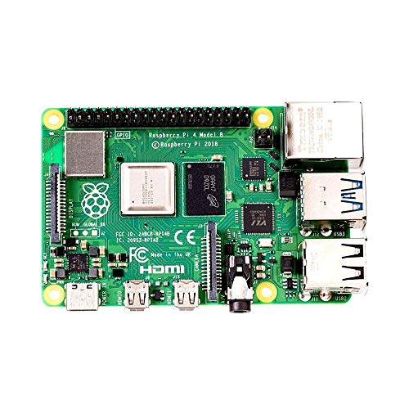

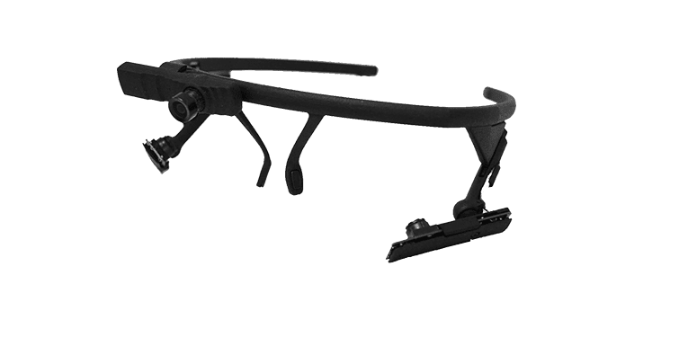
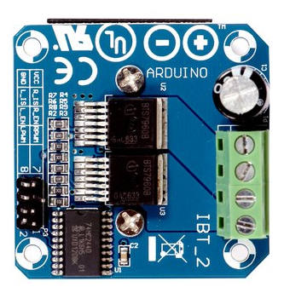
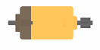

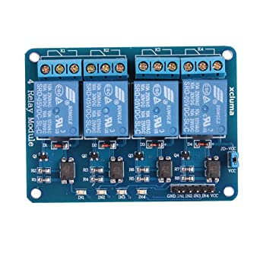
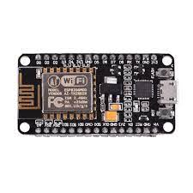
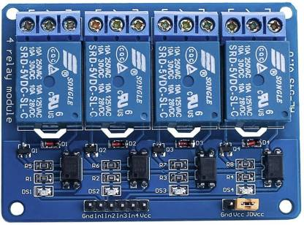
SCHEMATIC DIAGRAM
CAMERA MODULE
RASPBERRY PI 4
ARDUINO UNO
LEFT MOTOR
RIGHT MOTOR
RELAY CIRCUIT
NODE MCU
MOTOR DRIVER
Fig 1. Block Diagram of Smart Wheelchair
NODE MCU

Slide 10
SMART WHEELCHAIR
The whole project is divided into 3 parts:
Wheel Chair
Eye tracking module using Raspberry Pi 4
Home automation system using Node MCU

Slide 11
SMART WHEELCHAIR
Eye tracking module using Raspberry Pi 4:
Camera Module is used to capture eye movements.
The eye movement is tracked using the python eye tracking model using Raspberry Pi 4.
The position of the pupil is transferred to Node MCU.

Slide 12
SMART WHEELCHAIR
Wheel Chair
Wheel chair is also controlled on the basis of the control signal received from Raspberry Pi 4.
The wheel chair operates at low speed for safety.

Slide 13
SMART WHEELCHAIR
Home automation system using Node MCU:
From the position received from Raspberry Pi 4, appropriate decision is taken by the Node MCU.
Control by Node MCU include the switches of light and fan.

Slide 14
WHEEL CHAIR DESIGN
During the movement of a wheelchair, there are some resistances that appear.
Rolling resistance
Aerodynamic resistance
Inertial resistance

Slide 15
Calculation of Rolling Resistance
When an unformulated wheel is wrapped in unformed ground or, respectively, a fully resilient wheel is wound on a fully developed ground, there is no resistance to the movement.
In reality both the ground and the wheel suffer from deformations.
T_{r} = N×a ------(1)
To balance this torque, it is necessary to develop a torque opposite to this.
This torque equals the product of the pulling force F_{r} and the dynamic radius of the wheel.

Slide 16
Calculation of Rolling Resistance
Vertical force (F_{z}) which expresses the mass of a body in strength equals to:
F_{z} = m×g -----------(2)
where m is the body mass and g is the acceleration of gravity.
The rolling resistance F_{r} is described by the following formula:
F_{r} = F_{z} × μ_{r} ------------(3)
Where μ_{r} is the rolling resistance coefficient which is estimated for the wheelchairs with non- pneumatic wheels on concrete, with the value of μ_{r} = 0.015.

Slide 17
Calculation of Rolling Resistance
For the calculation of the wheelchair rolling resistance is taken into account the masses of :
Wheelchair, m₁ = 7kg
User, m₂ = 100kg
Battery, m₃ = 2×2.5kg = 5kg
Motor, m₄ = 2×2.35kg = 4.7kg
Auxiliary weight, m₅ = 200g
Total weight, M= m₁+m₂+m₃+m₄+m₅
= 7+100+5+4.7+0.2 = 116.9kg ≈ 117kg

Slide 18
Calculation of Rolling Resistance
F_{z} = M ×g ----------(4)
F_{z} = 117 × 9.81
F_{z} = 1147.77 N
M is the total mass in kilogram
F_{r} = F_{z}×μ_{r} ------------(5)
F_{r} = 1147.77 × 0.015
F_{r} = 17.2 N

Slide 19
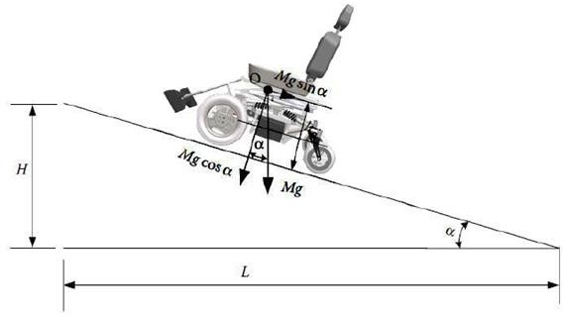
Calculation of Rolling Resistance
When climbing a vehicle due to road inclination, a resulting force from the weight of the vehicle appears as shown in Fig 2.
This force opposes the movement of the vehicle when it is on the hill.
Fig 2. Forces in road inclinations.

Slide 20
Calculation of Rolling Resistance
The ascent resistance F_{B} is calculated from the following formula:
F_{B}=F_{z}× sin α--------------(6)
Where F_{z} is vertical force in newtons and α is the angle of the road inclination.
Tilt of the road is the ratio of the height H to the distance L (Fig 1) and expresses the height to be developed at a distance of 100 km:
i = Η/L = tan α ≈ sin α------------(7)
To find the angle α, in order to calculate the ascent resistance, the right formula is the following:
α=tan⁻¹(i)

Slide 21
Calculation of Rolling Resistance
Thus, for a pavement slope of 10º the vehicle has an ascent resistance equals to:
F_{B}= 1147.77 × Sin10 = 199.31 N
F_{t}= F_{r} + F_{B} = 17.2+ 199.31 = 216.51 N
Where F_{t} is the total traction force which is the sum of ascent resistance F_{B} and the rolling resistance F_{r}
The torque needed on the wheel to overcome these resistors is calculated by the formula:
F_{t} = M_{k} × i_{tot}/r_{t} => M_{k} = F_{t} × r_{t} / i_{tot}
Where M_{k} is the torque on the wheel in Nm

Slide 22
Calculation of Rolling Resistance
The r_{t} the radius of the wheel and i_{tot} its gear transmission ratio from the motor to the wheel.
The motors have a diameter of 12inch (308mm) with a working voltage of 24V, 250Watt and a fixed gear transmission ratio of 23: 1.
The maximum torque that can be produced by the motor according to its operating diagram is 20Nm and is enough to overcome the climb and roll resistors.
F_{t} = M_{k} × i_{tot} / r_{t}
M_{k} = F_{t} × r_{t} / i_{tot}
= 216.15 × 0.154 / 23
= 1.5 Nm

Slide 23
Calculation of Rolling Resistance
According to standard values maximum speed of motor is 220 rpm and the maximum speed that the wheelchair can develop is 12Km/h.
This is calculated by the following formula:
N = V × 60/2 × π × r
V = N × 2 × π × r / 60
= 216.51 × 2 × π × 0.154/60
V = 3.50 m/s
V = 12.6 Km/h
Where V is the maximum speed that wheelchair can achieve in Km/h, n is motors speed in rpm and r is wheelchair’s wheel radius in m.

Slide 24
Calculation of Power
Work results when a force acts upon an object to cause a displacement (or a motion) or, in some instances, to hinder a motion.
Three variables are of importance in this definition
Force
Displacement
The extent to which the force causes or hinders the displacement
Each of these three variables find their way into the equation for work.
W=F×χ
Where W is the work in Joules, F is force in N and χ is the displacement in meters

Slide 25
Calculation of Power
Considering the above mathematical formulas and knowing the velocity it follows that:
P = F_{t}×V_{t}
Where P is the power in watts F_{t} is the traction force in N and V_{t} is the velocity in m/s.
Theoretically, the power given to the vehicle, when it moves at the maximum speed (3.50m/s) it can develop:
P = F_{t}×V_{t}
P= 17.2N × 3.50 m/s P= 60.2 Watt

Slide 26
Calculation of Power
The needed energy to drive the vehicle for one hour is calculated by the formula:
E= P×t
E = 0.0602KWh
Where E is the energy in KWh, P is power in watt and t is the time in hours.
According to the formula below, the vehicle needs 2.50Ah to move one hour at maximum speed.

Slide 27
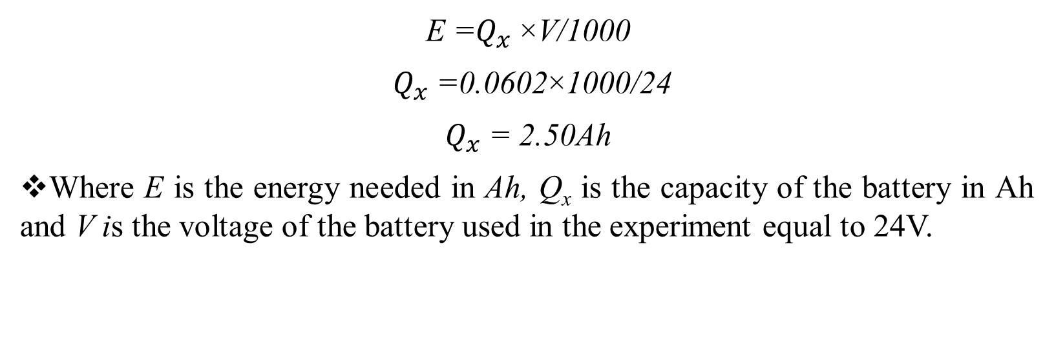
Calculation of Power
E =$Q_{x}$×V/1000
$Q_{x}$=0.0602×1000/24
$Q_{x}$= 2.50Ah
Where E is the energy needed in Ah, Q_{x} is the capacity of the battery in Ah and V is the voltage of the battery used in the experiment equal to 24V.

Slide 28
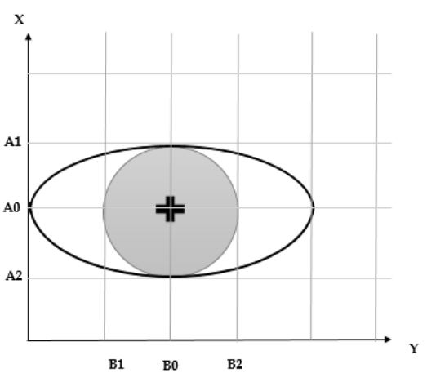
EYE TRACKING ALGORITHM
Fig 3. Detection of Pupil in Eye Tracking Algorithm

Slide 29
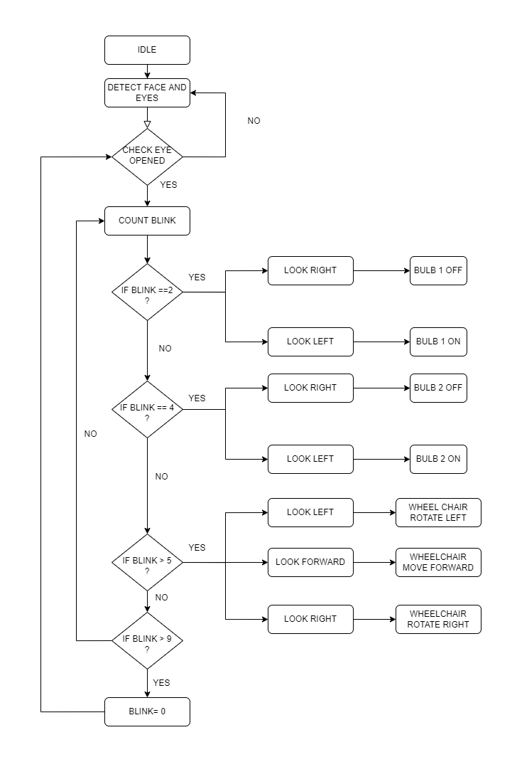
Fig 4. Flow Chart of Eye Tracking Program

Slide 30
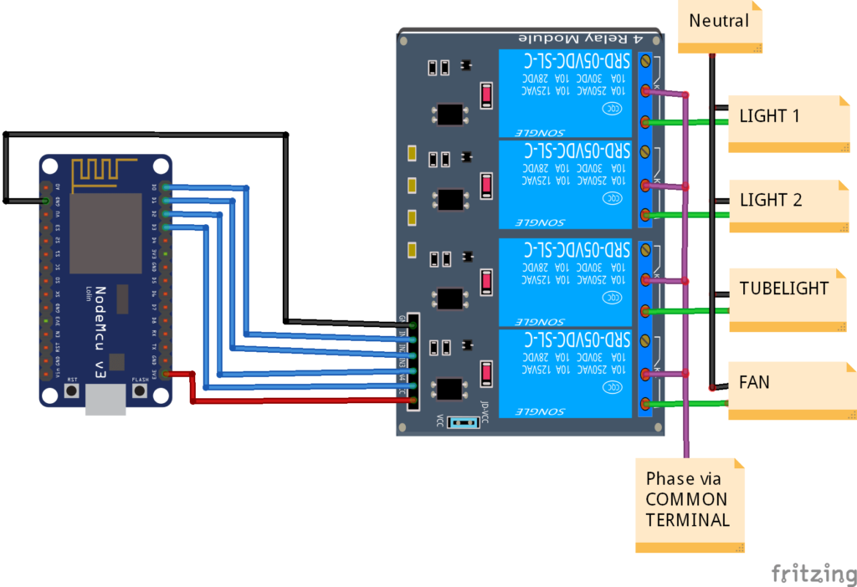
HOME AUTOMATION SYSTEM
Fig 5. Home Automation System Using Node MCU and Bluetooth Module

Slide 31
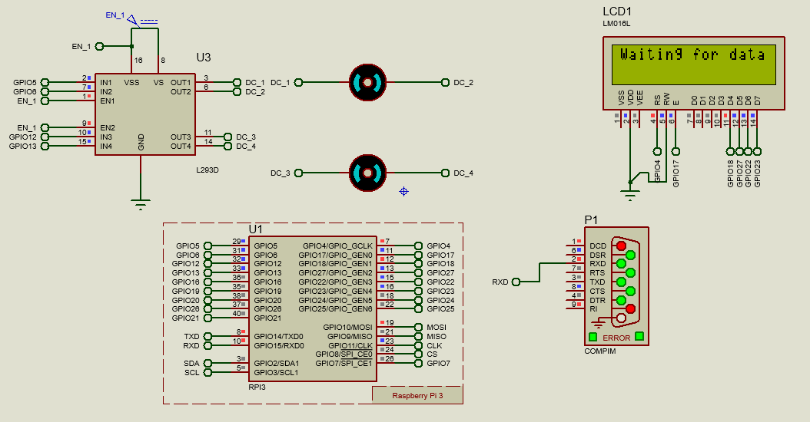
SIMULATION OF WHEELCHAIR
Simulation of Smart Wheel Chair
Fig 6. Simulation Model of Smart Wheelchair

Slide 32
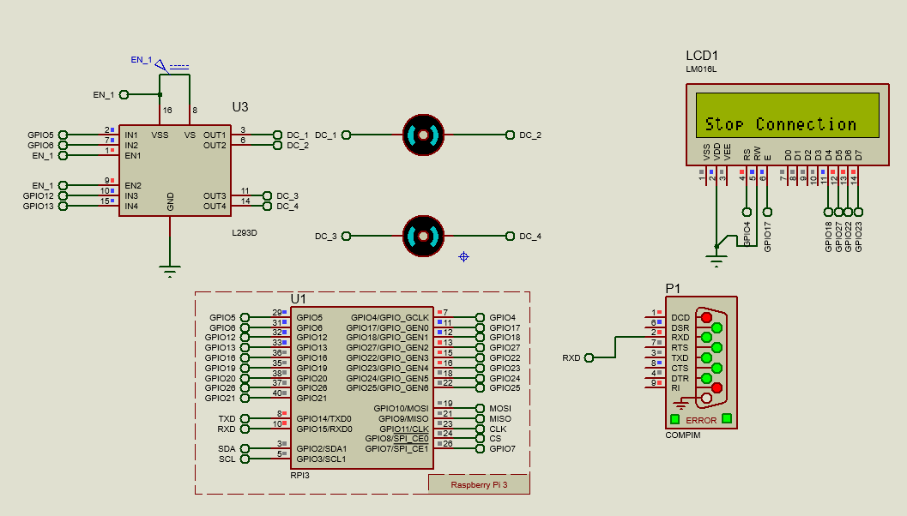
SIMULATION OF WHEELCHAIR
Simulation of Smart Wheel Chair
Fig 7. Simulation Model of Smart Wheelchair

Slide 33
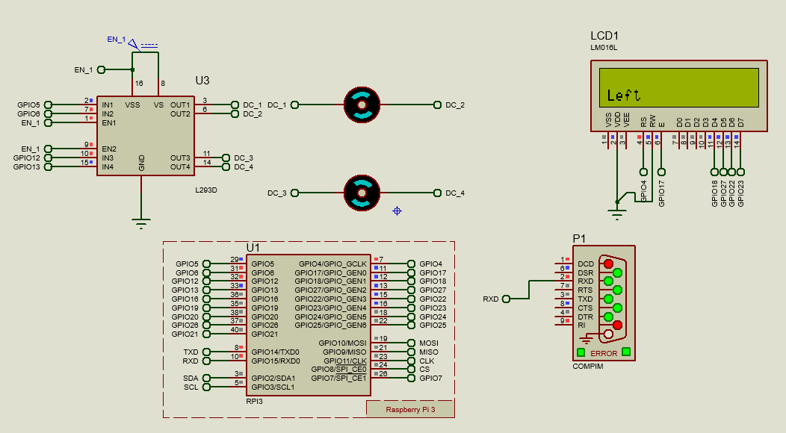
SIMULATION OF WHEELCHAIR
Simulation of Smart Wheel Chair
Fig 8. Simulation Model of Smart Wheelchair

Slide 34
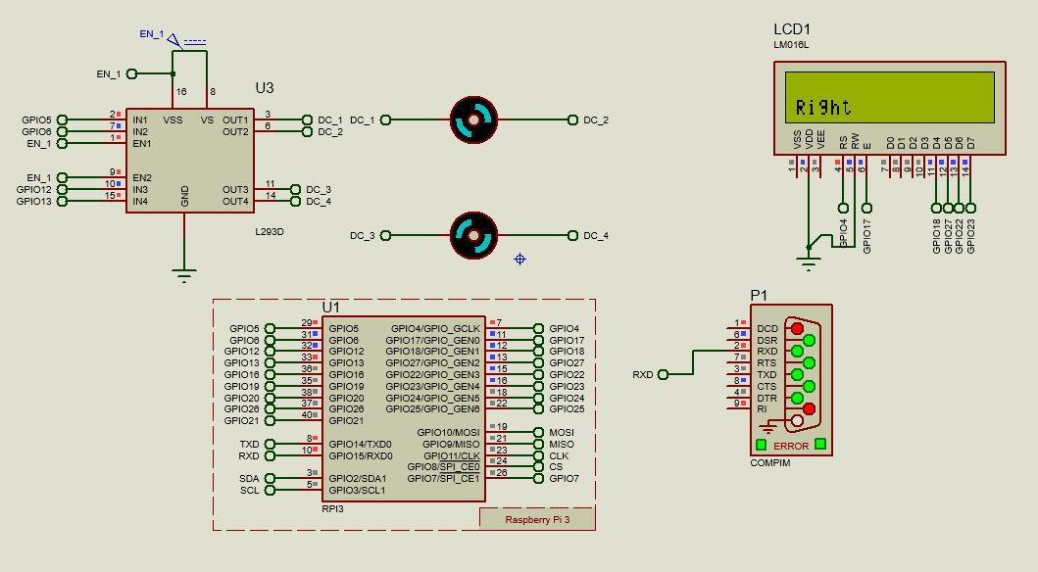
SIMULATION OF WHEELCHAIR
Simulation of Smart Wheel Chair
Fig 9. Simulation Model of Smart Wheelchair

Slide 35
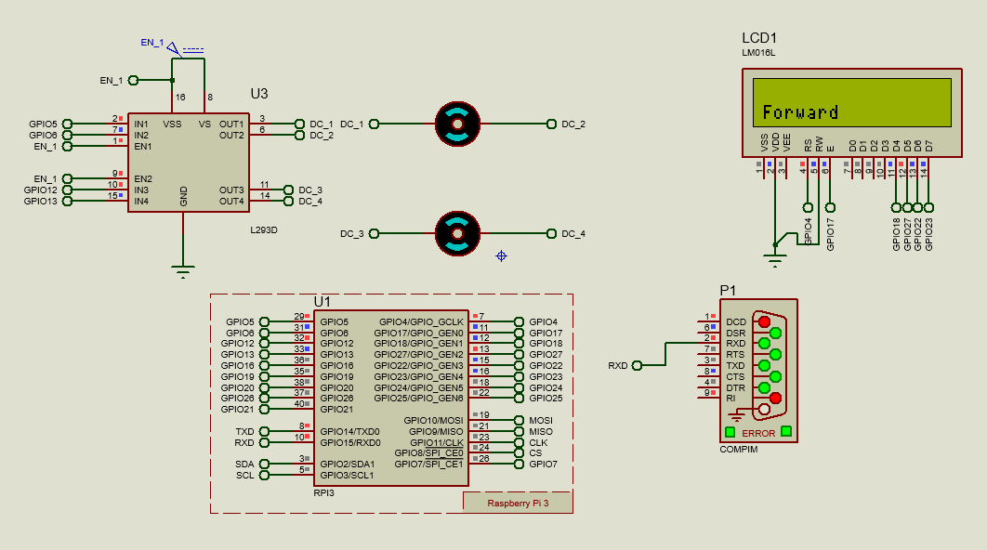
SIMULATION OF WHEELCHAIR
Simulation of Smart Wheel Chair
Fig 10. Simulation Model of Smart Wheelchair

Slide 36
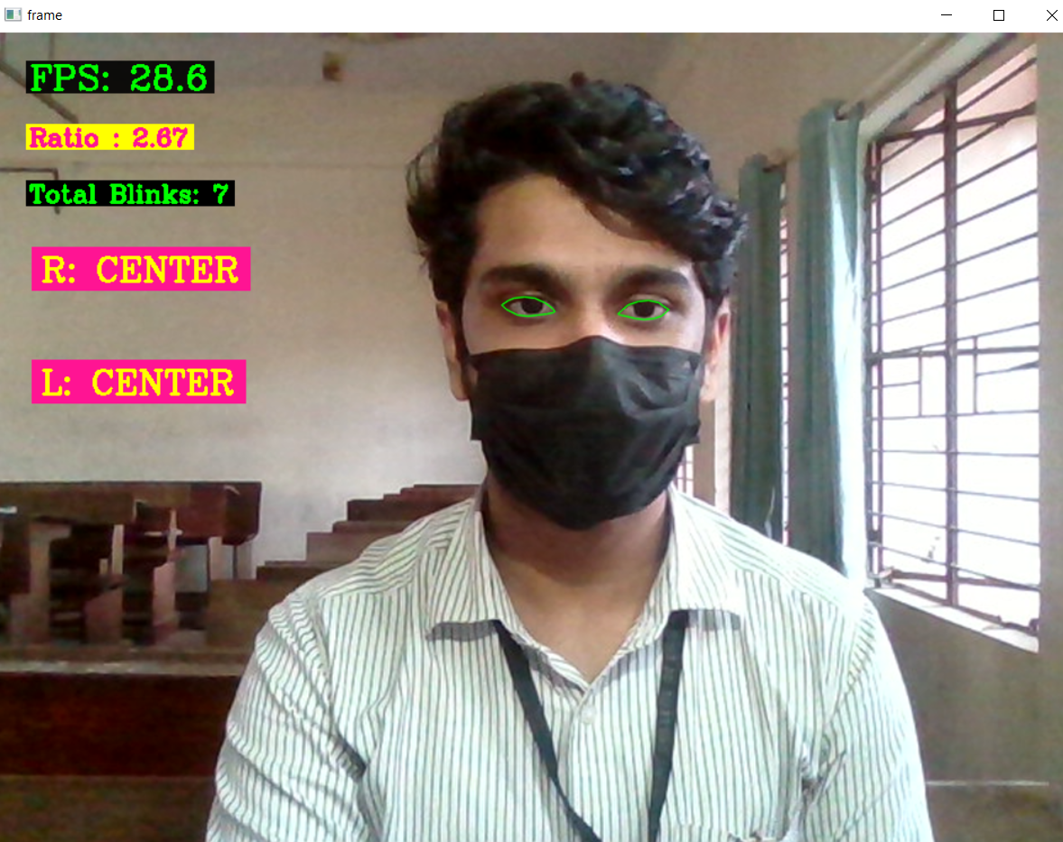
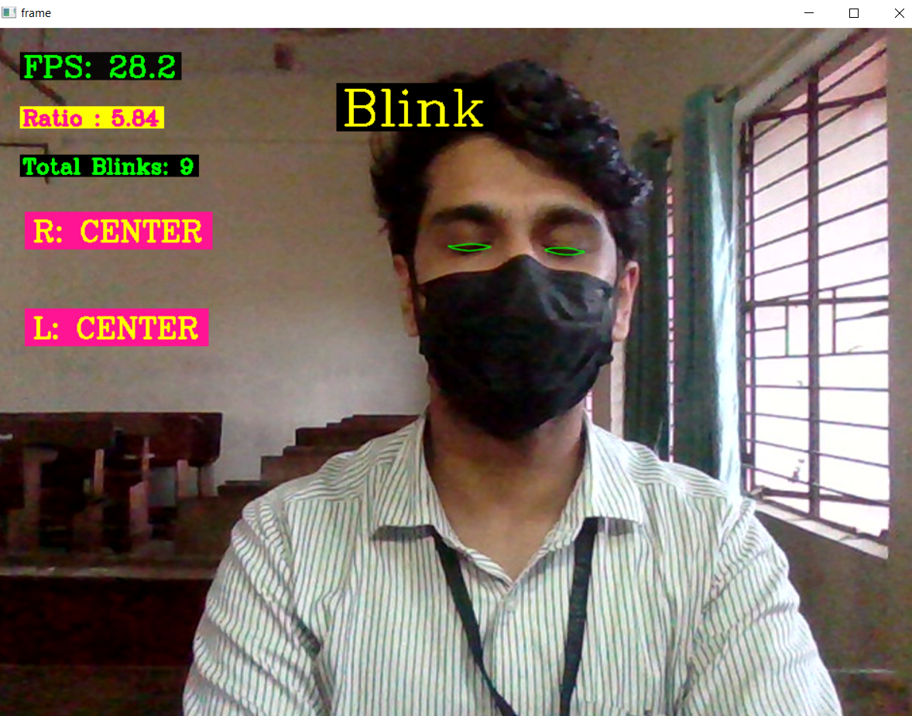

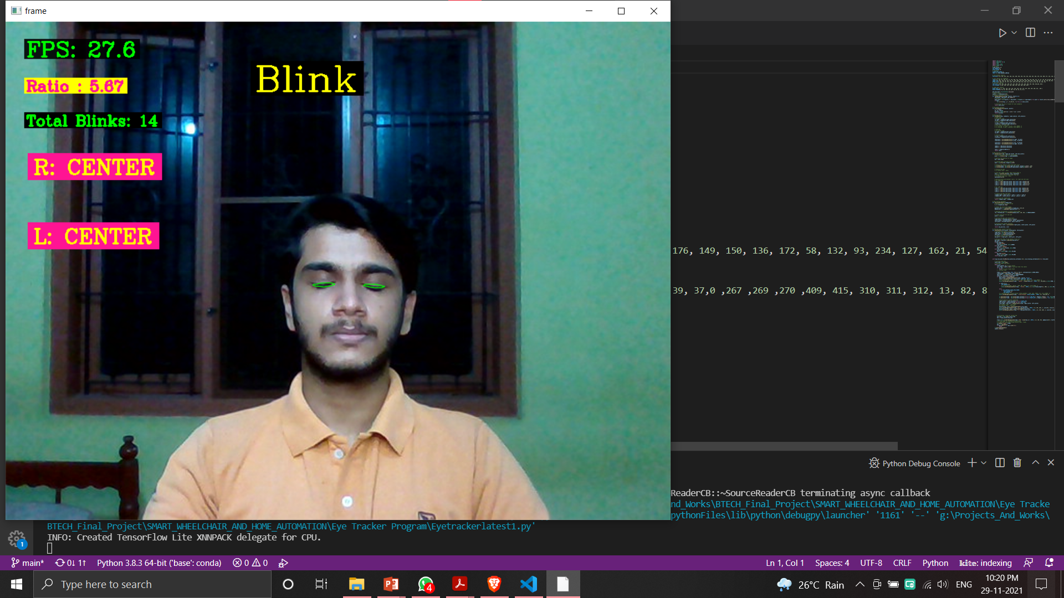
EYE TRACKING
Eye tracking program is developed and its results are shown below.
Fig 11.Straight
Fig 12. Closed

Slide 37
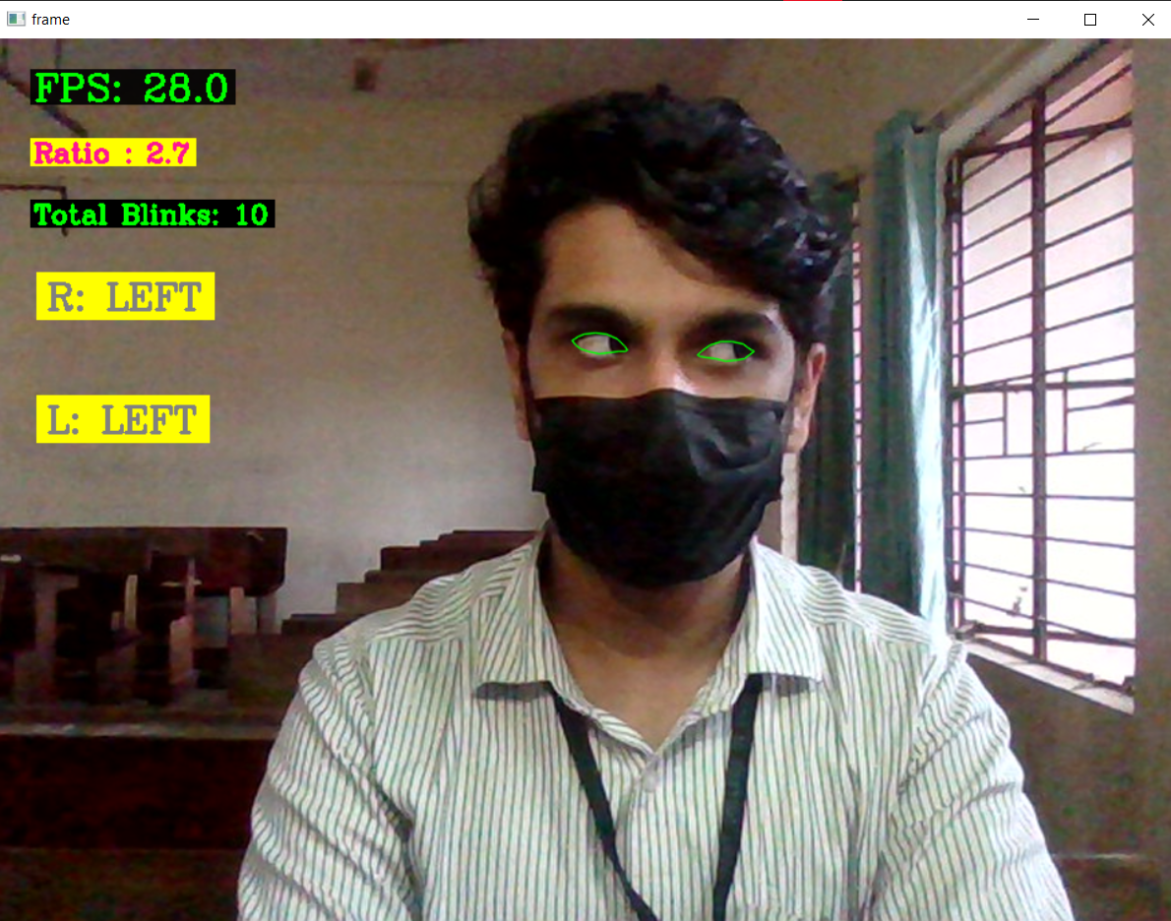
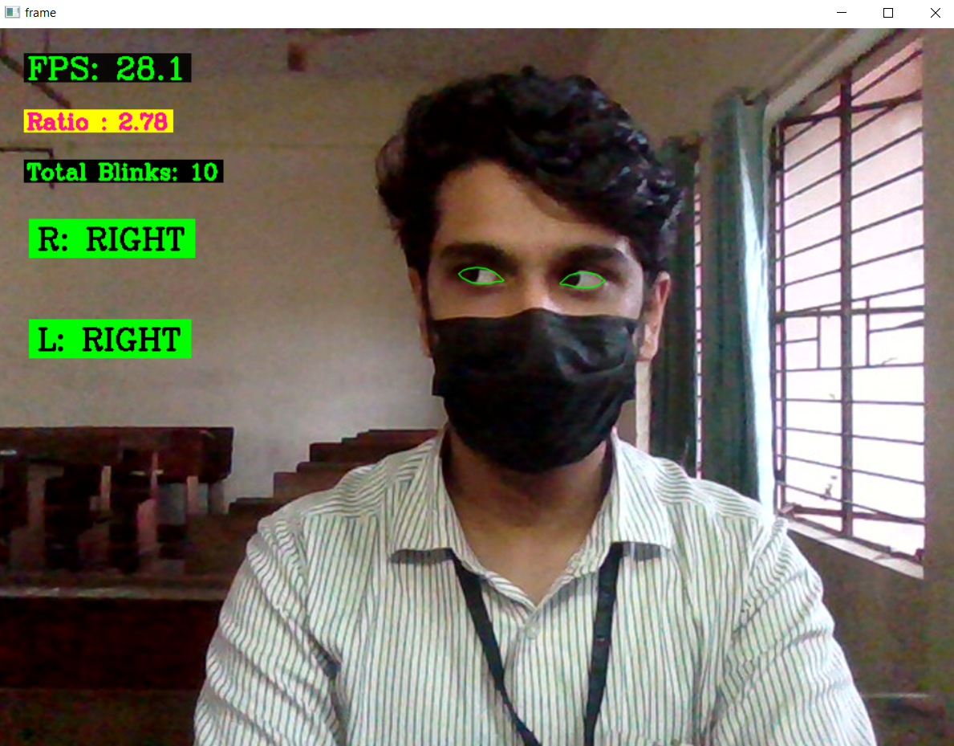


EYE TRACKING
Eye tracking program is developed and its results are shown below.
Fig 13. Left
Fig 14. Right

Slide 38
RASPBERRY PI 4 CONFIGURATION
Hardware required:
Raspberry Pi 4
RJ45 LAN cable
32GB SD card and adapter
Software required:
Raspberry Pi OS
VNC Viewer and VNC Server
PuTTY Software

Slide 39

RASPBERRY PI INTERFACE
Fig 15. Raspbian OS Desktop Interface

Slide 40
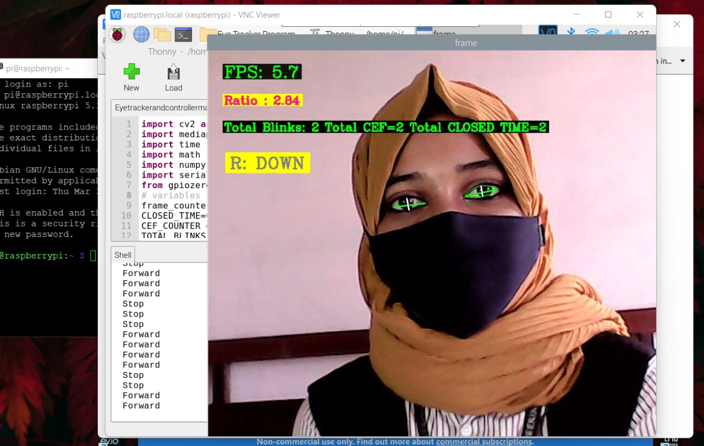
EYE TRACKING PROGRAM
Tested eye tracking program on Raspberry Pi 4
Fig 16. Eye tracking program on Raspberry Pi 4

Slide 41
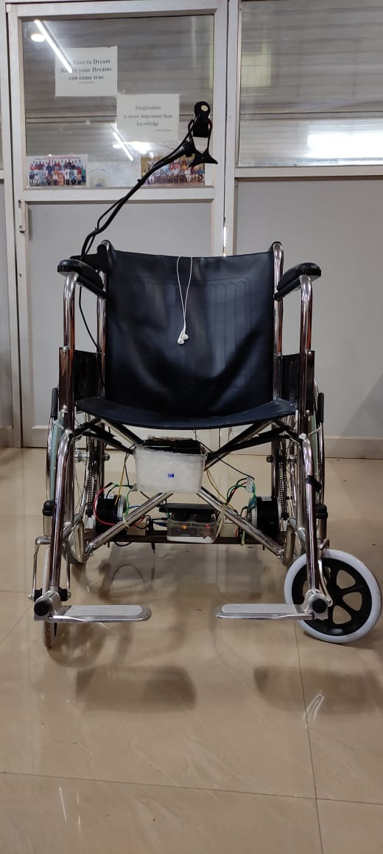
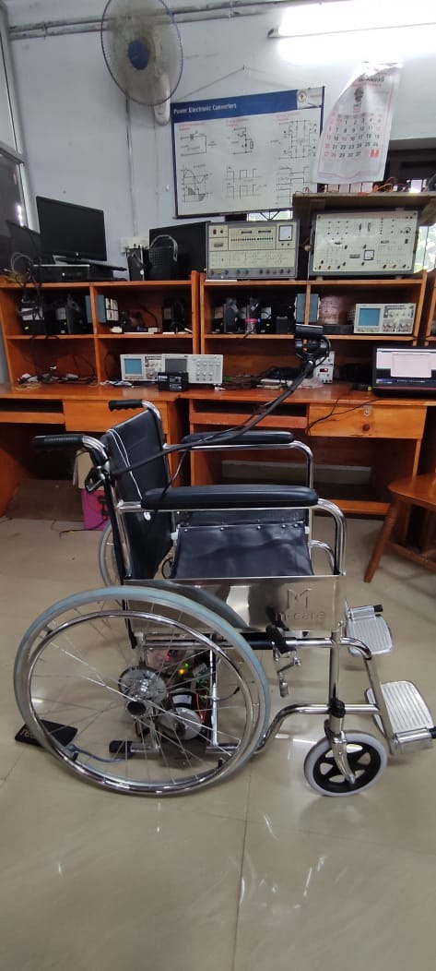
WORKING MODEL
Implementation of smart wheelchair
Fig 17. Smart wheelchair

Slide 42
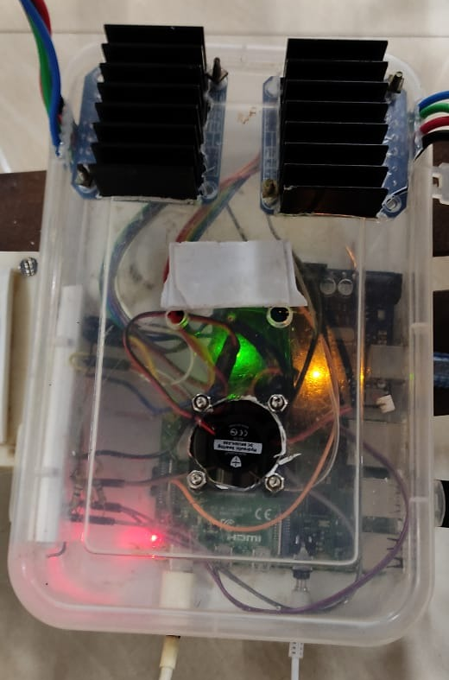
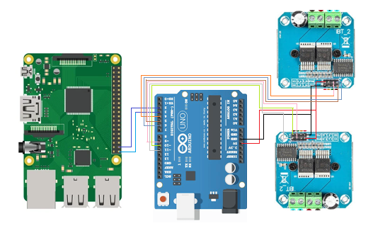
WORKING MODEL
Hardware setup for eye tracking and wheelchair control
Fig 18. Circuit inside controller setup
Fig 19. Wheelchair control setup

Slide 43
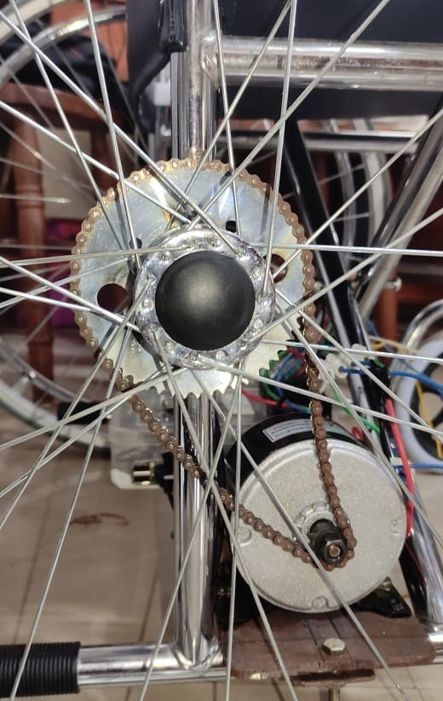
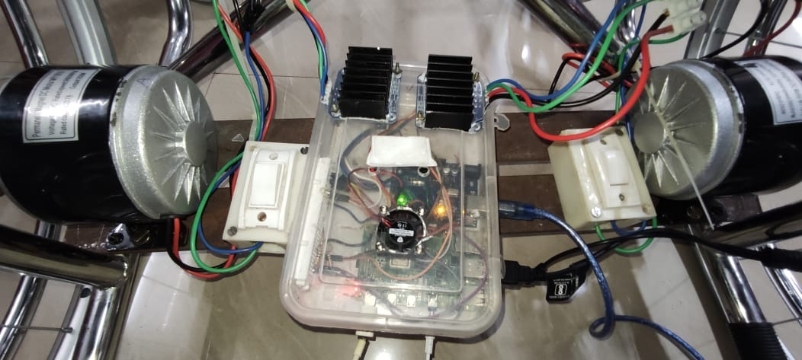
WORKING MODEL
Conversion to electric wheelchair.
Fig 20. Electric conversion
of wheelchair
Fig 21. Chain and sprocket arrangement

Slide 44
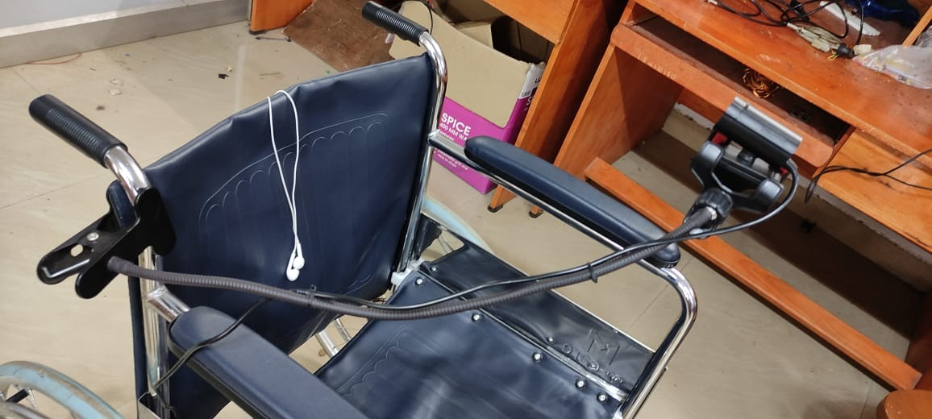
WORKING MODEL
Camera arrangement in wheelchair
Fig 22. Camera setup

Slide 45
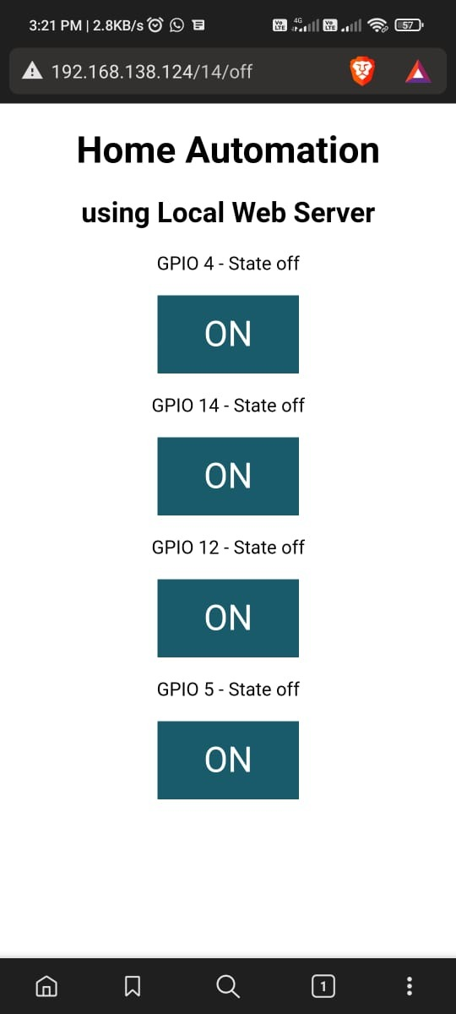
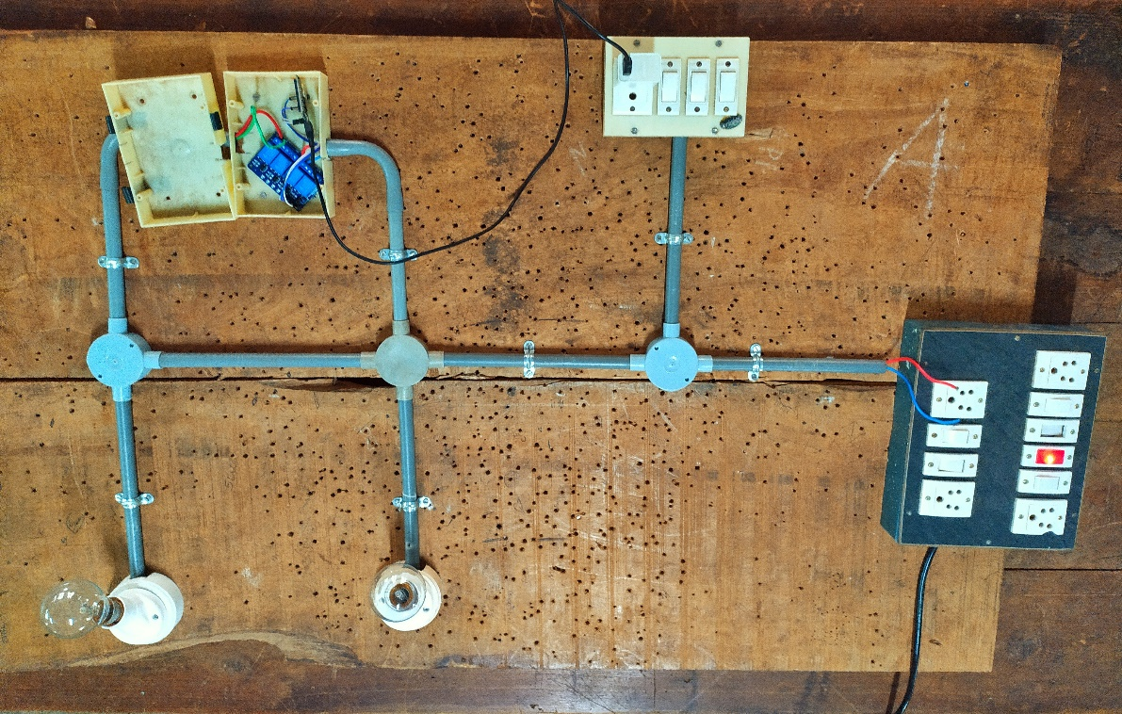
WORKING MODEL
Implementation of Home Automation System
Fig 23. Home Automation System
Fig 24. Web server interface for Home Automation System

Slide 46
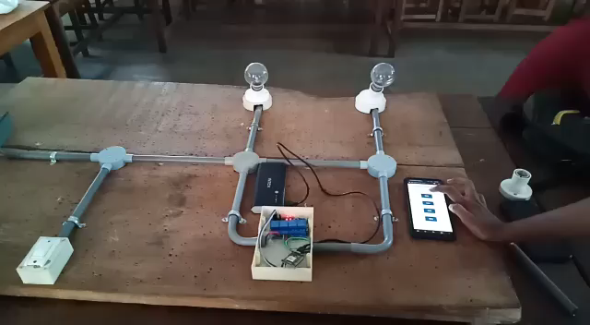
WORKING MODEL
Fig 23. Control of Home Automation System with external device

Slide 47
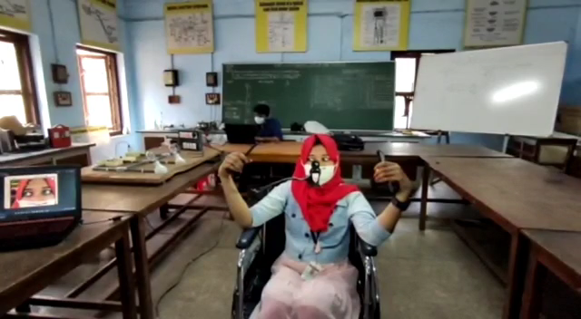

WORKING OF WHEELCHAIR
Home automation by eye tracking.
Fig 24. First bulb control
Fig 25. Second bulb Control

Slide 48
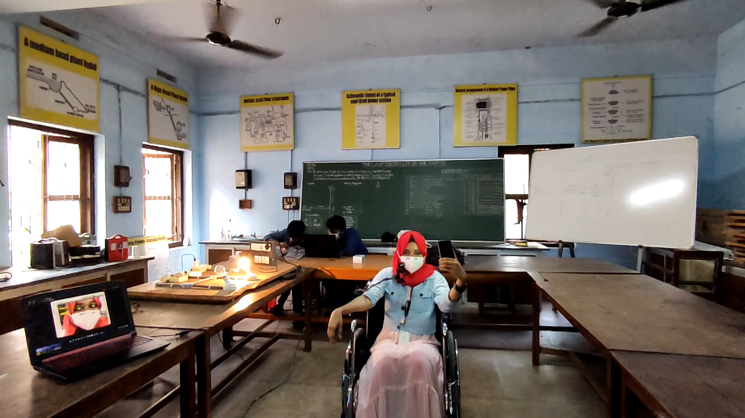
WORKING OF WHEELCHAIR
Forward movement of wheelchair
Fig 26. Forward Movement

Slide 49
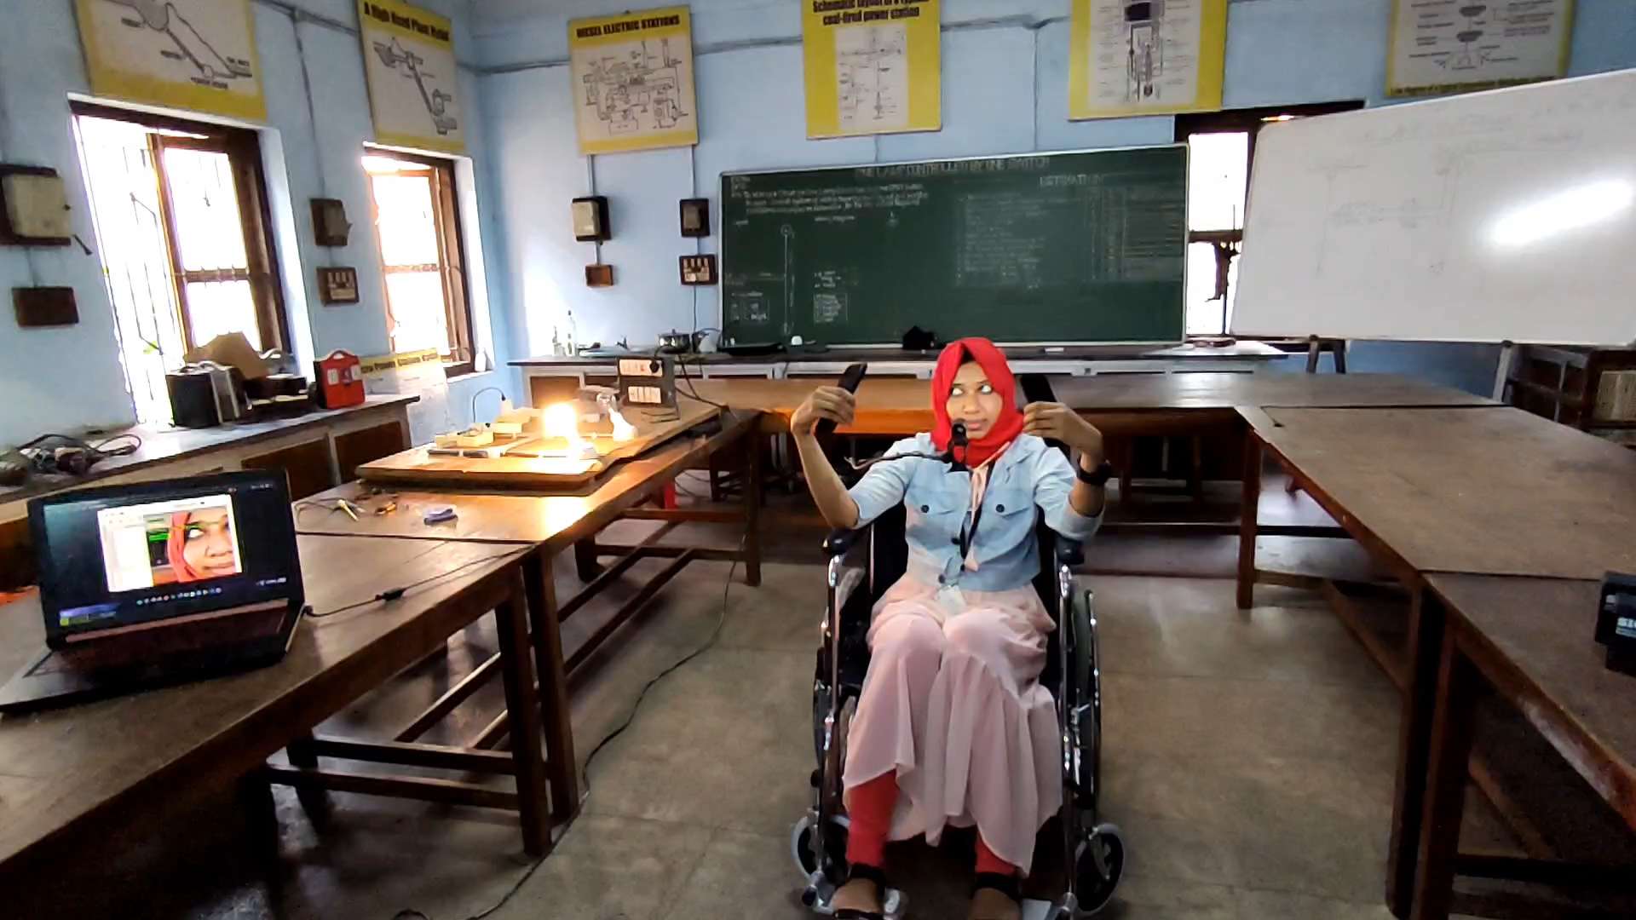
WORKING OF WHEELCHAIR
Left movement of wheelchair
Fig 27. Left Movement

Slide 50
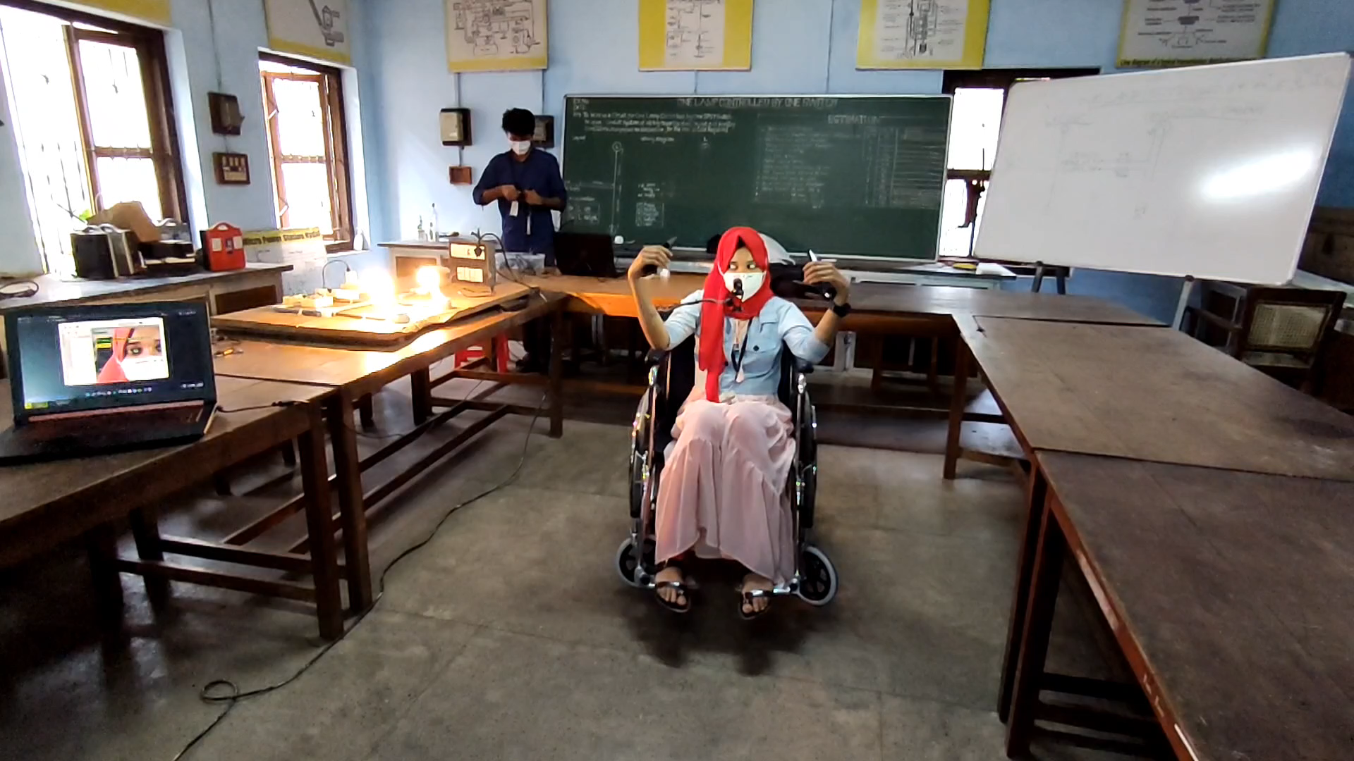
WORKING OF WHEELCHAIR
Right movement of wheelchair
Fig 28. Right Movement

Slide 51
LIMITATIONS
Detection is difficult in dim light.
Chain and sprocket system is not efficient.
Detection is difficult for users wearing spectacles and eye liner.
Breaking is not provided.

Slide 52
FUTURE SCOPES
Use of night vision cameras helps in dim light instead of normal camera.
Use of hub motors improves the efficiency of the wheelchair.
Breaking and speed control with the help of position sensors in the wheels.

Slide 53
CONCLUSION
Designed and implemented the electric smart wheelchair.
Wheelchair is controlled by tracking eye movement.
The basic devices like fan, bulb, etc. can be controlled either by eye tracking or by web server.
Limitations of the wheelchair is identified.

Slide 54
REFERENCE
[1]Diksha Raj, Anish Kalra, Sreejith Krishna N, Suhriday Roy, Dr. Shreenath K N, "Wagon-The Smart Wheelchair", International Journal of Emerging Technologies and Innovative Research, vol. 8, Issue 8, pp. b343-b349, August 2021
[2]D. Das, P. Saha and N. Tabassum, "Real Time Distance and Mobility Detection of Obstacles Using a Smart Multisensor Framework for Visually Impaired People", 2020 IEEE Region 10 Symposium (TENSYMP), pp. 590-593, doi: 10.1109/TENSYMP50017.2020.9230880, 2020
[3] Y. C. Lee and C. M. Lee, "Real-Time Smart Home Surveillance System of Based on Raspberry Pi", 2020 IEEE Eurasia Conference on IOT, Communication and Engineering (ECICE), pp. 72-74, doi: 10.1109/ECICE50847.2020.9301929, 2020

Slide 55
REFERENCE
[4]Reona Cerejo, Valentine Correia and Neil Pereira, “Eye Controlled Wheelchair based on Arduino Circuit”, International Journal of Technical Research and Applications, vol. 3, Issue 6, pp. 94-98, 2015
[5]Muhammad Azlan Alim, Samsul Setumin, Anis Diyana Rosli, Adi Izhar Che Ani, “Development of a Voice-controlled Intelligent Wheelchair System using Raspberry Pi”, International Conference on Applied Sciences, Information and Technology, vol. 846, 2021
[6]V. U. Rani, J. Sridevi and P. M. Sai, "Web Controlled Raspberry Pi Robot Surveillance", 2021 International Conference on Sustainable Energy and Future Electric Transportation (SEFET), pp. 1-5, doi: 10.1109/SeFet48154.2021.9375666, 2021

Slide 56
REFERENCE
[7]Fahad Wallam and Muhammad Asif, “Dynamic Finger Movement Tracking and Voice Commands Based Smart Wheelchair”, International Journal of Computer and Electrical Engineering, vol. 3, pp. 497-502 ISSN: 1793-8163 doi:10.7763/IJCEE.2011.V3.368, 2021
[8]Al-Okby, Mohammed & Neubert, Sebastian & Stoll, Norbert & Thurow, Kerstin. “Low-cost Hybrid Wheelchair Controller for Quadriplegias and Paralysis Patients”, Advances in Science, Technology and Engineering Systems Journal, pp. 687-694, doi:10.25046/aj020388, 2017
[9]Luis A. Rivera, Guilherme N. DeSouza, “An Automatic Wheelchair Controlled using Hand Gestures”, IEEE, University of Missouri, April 2010.

Slide 57
REFERENCE
[10]F. Klaib, N. O. Alsrehin, W. Y. Melhem, H. O. Bashtawi,and A. A. Magableh, “Eye tracking algorithms, techniques, tools, and applications with an emphasis on machine learning and internet of things technologies”, Expert Systems with Applications, vol. 166, pp. 114037–114174, 2021
[11]P. A. Punde, M. E. Jadhav and R. R. Manza, "A study of eye tracking technology and its applications", 2017 1st International Conference on Intelligent Systems and Information Management (ICISIM), pp. 86-90, doi: 10.1109/ICISIM.2017.8122153, 2017
[12]Tan Kian Hou, Yagasena and Chelladurai, “Arduino based voice controlled wheelchair”, First International Conference on Emerging Electrical Energy, Electronics and Computing Technologies, vol. 1432, doi:10.1088/1742-6596/1432/1/012064, 2019

Slide 58
REFERENCE
[13]M. H. A. Sibai and S. A. Manap, “A study on smart wheelchair systems”, International Journal of Engineering Technology and Sciences, vol. 4, pp. 25–35, doi:10.15282/ijets.4.2015.1.4.1033, 2015
[14]Deepak Kumar, Reetu Malhotra, S.R. Sharma, “Design and Construction of a Smart Wheelchair”, Procedia Computer Science, vol. 172, pp. 302-307, doi:10.1016/j.procs.2020.05.048, 2020
[15]G. Boustany, A. El Deen Itani, R. Youssef, O. Chami and Z. O. Abu-Faraj, "Design and development of a rehabilitative eye-tracking based home automation system," 2016 3rd Middle East Conference on Biomedical Engineering (MECBME), pp. 30-33, doi: 10.1109/MECBME.2016.7745401, 2016

Slide 59
REFERENCE
[16]Joseph K George, Subin K B, Arun Jose, Hima T, “Eye Controlled Home-Automation For Disables”, IOSR Journal of Electrical and Electronics Engineering, pp. 06-08, 2017
[17]Deepak Kumar Lodhi, Prakshi Vats, Addala Varun, Prashant Solanki, Ritakshi Gupta1, Manoj Kumar Pandey, Rajat Butola, “Smart Electronic Wheelchair Using Arduino and Bluetooth Module”, International Journal of Computer Science and Mobile Computing, vol. 5, pp. 433-438, 2016
[18]Airi Ishizuka, Ayanori Yorozu and Masaki Takahashi, “Driving Control of a Powered Wheelchair Considering Uncertainty of Gaze Input in an Unknown Environment”, Applied Sciences , doi: 10.3390/app8020267, 2018

Slide 60
REFERENCE
[19]M. A. Eid, N. Giakoumidis and A. El Saddik, "A Novel Eye-Gaze-Controlled Wheelchair System for Navigating Unknown Environments: Case Study with a Person with ALS", in IEEE Access, vol. 4, pp. 558-573, doi: 10.1109/ACCESS.2016.2520093, 2016
[20]Mohammed Hayyan Al Sibai and Sulastri Abdul Manap, “A Study on Smart Wheelchair Systems”, International Journal of Engineering Technology and Sciences, doi:10.15282/ijets.4.2015.1.4.1033, 2015

Slide 61
THANK YOU

Slide 62
ESTIMATION OF COMPONENTS
Table 1. Estimation
SL No. | Component Name | Quantity | Price (Rs)
1 | 250W, 24V, 13.7A Motor | 2 | 4600
2 | 4 Channel Relay(Peak 30V DC Supply) | 1 | 240
3 | 12V, 7.2Ah Battery | 4 | 3000
4 | 15V,2.2A Battery Charger | 1 | 250
5 | Node MCU | 1 | 500
6 | Ultrasonic Sensors | 4 | 400
7 | DC Wire Socket | 1 | 10
8 | Raspberry Pi 4 | 1 | 5100
9 | Webcam | 1 | 1500
10 | Wheelchair | 1 | 7000

Slide 63
ESTIMATION OF COMPONENTS
Table 1. Estimation (Contd..)
SL No. | Component Name | Quantity | Price
11 | BTS7960B Bridge Motor Driver | 2 | 1600
12 | Fan | 1 | 220
13 | Sprocket and Chain | 2 | 550
14 | Camera Mount | 1 | 200
Total |  |  | 25170

Slide 64
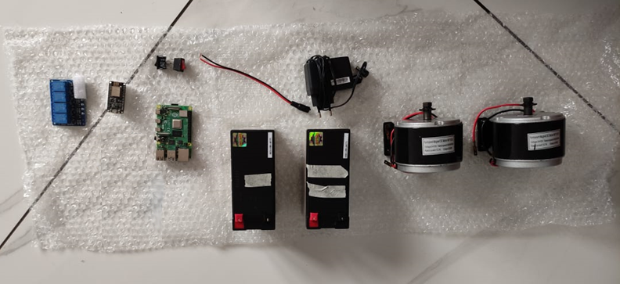
COMPONENTS
Fig 30. Components

Slide 65
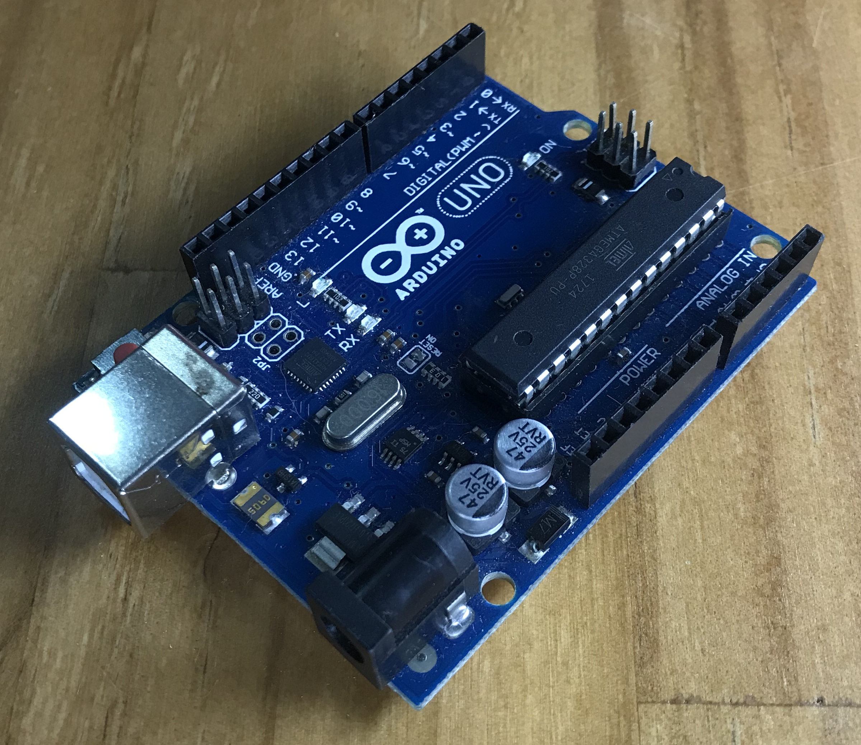
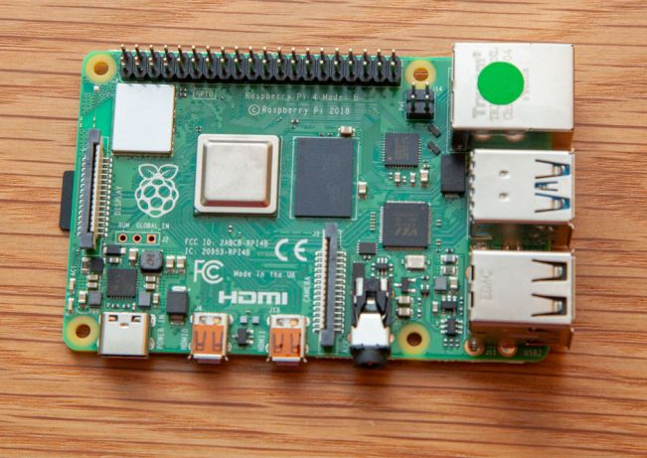
COMPONENTS
Fig 32. Arduino Uno
Fig 31. Raspberry Pi 4

Slide 66
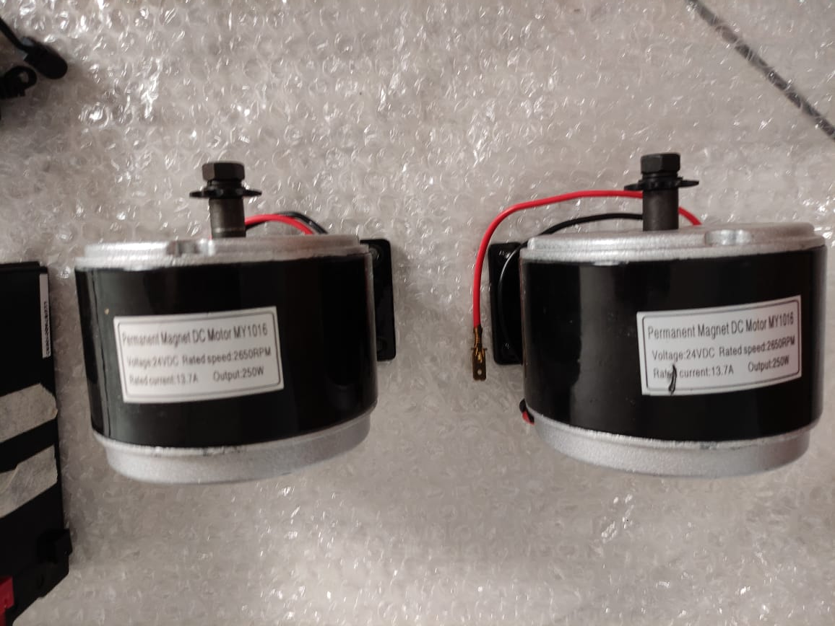
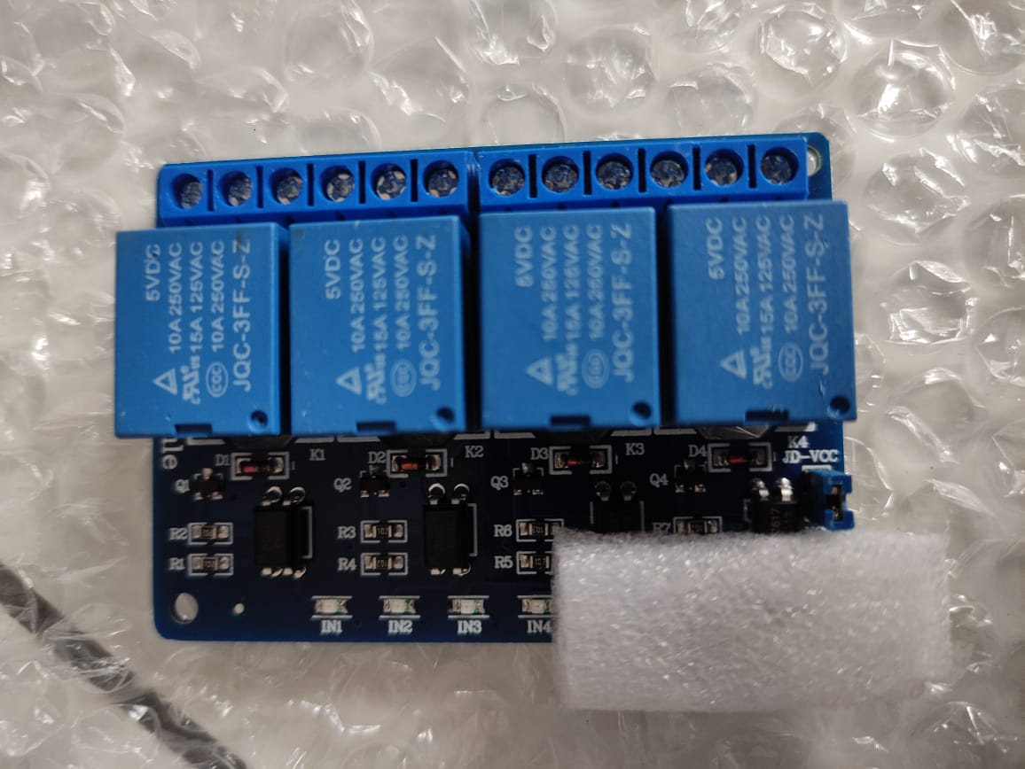
COMPONENTS
Fig 34. 4 Channel Relay(Peak 30V DC Supply)
Fig 33. 250W, 24V, 13.7A Motor

Slide 67
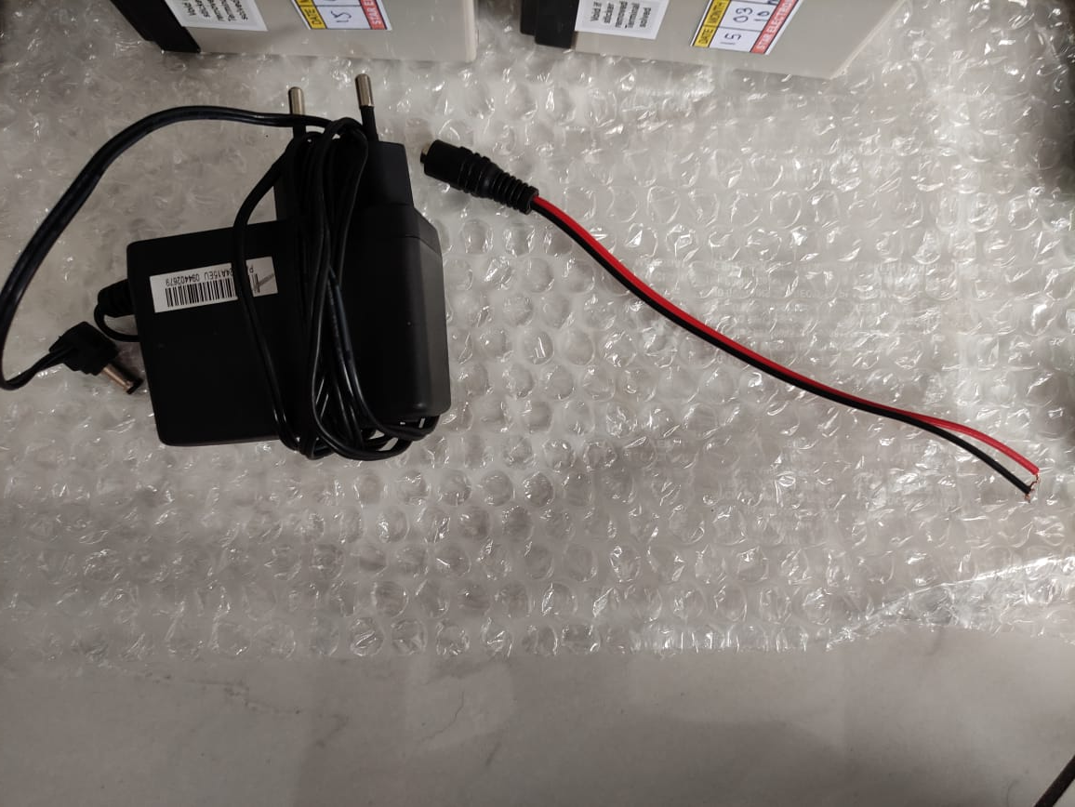
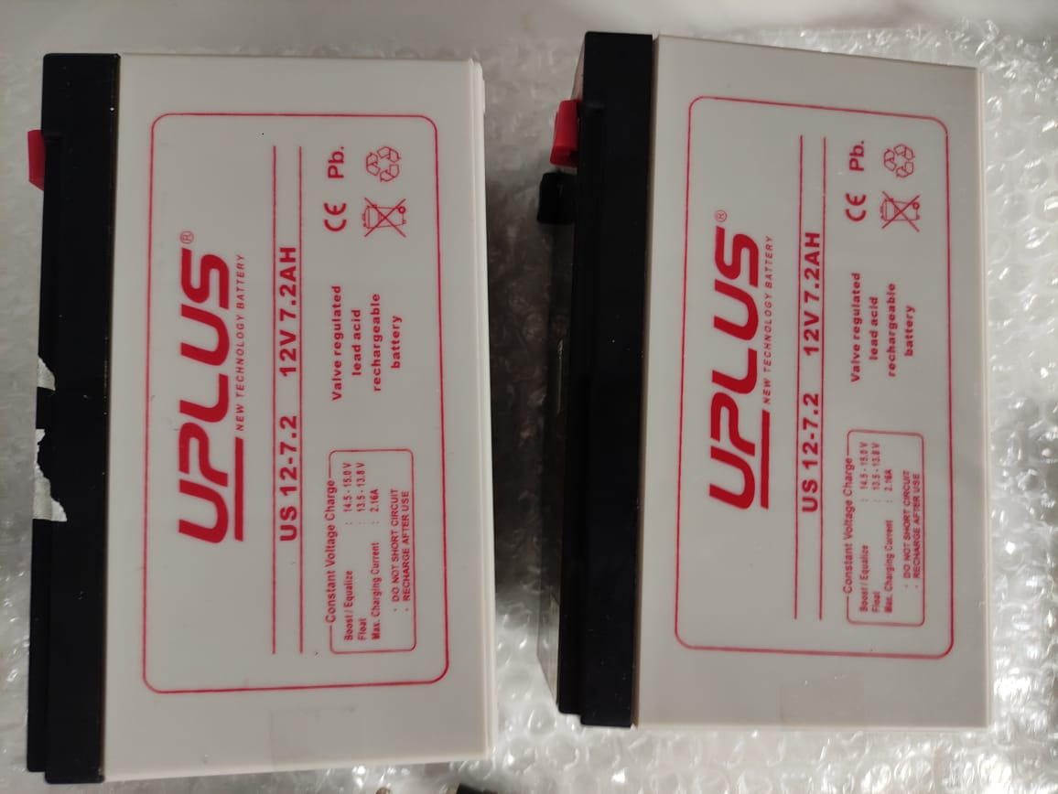
COMPONENTS
Fig 36. Battery Charger and Connector
Fig 35. 12V, 7.2Ah Battery

Slide 68
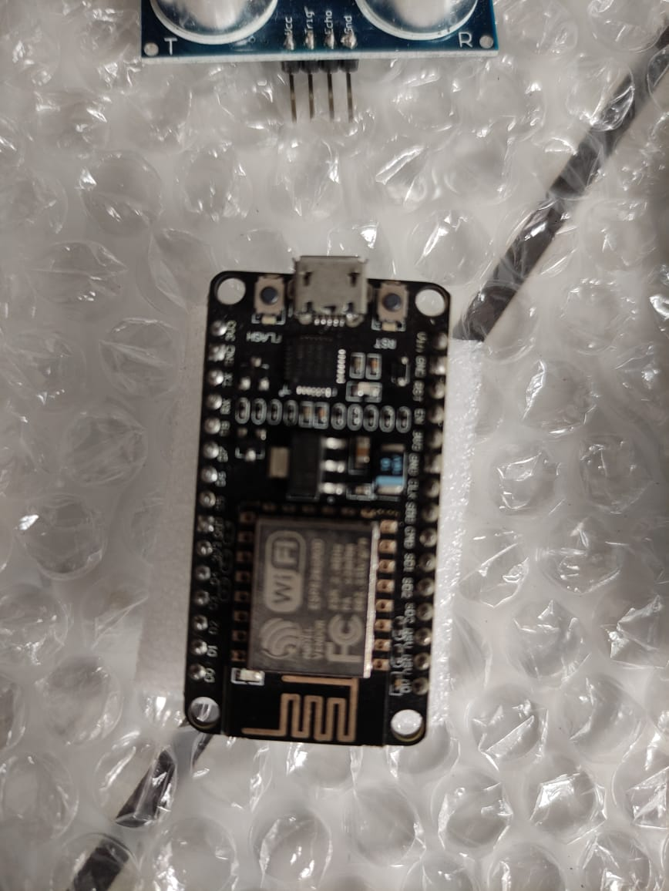
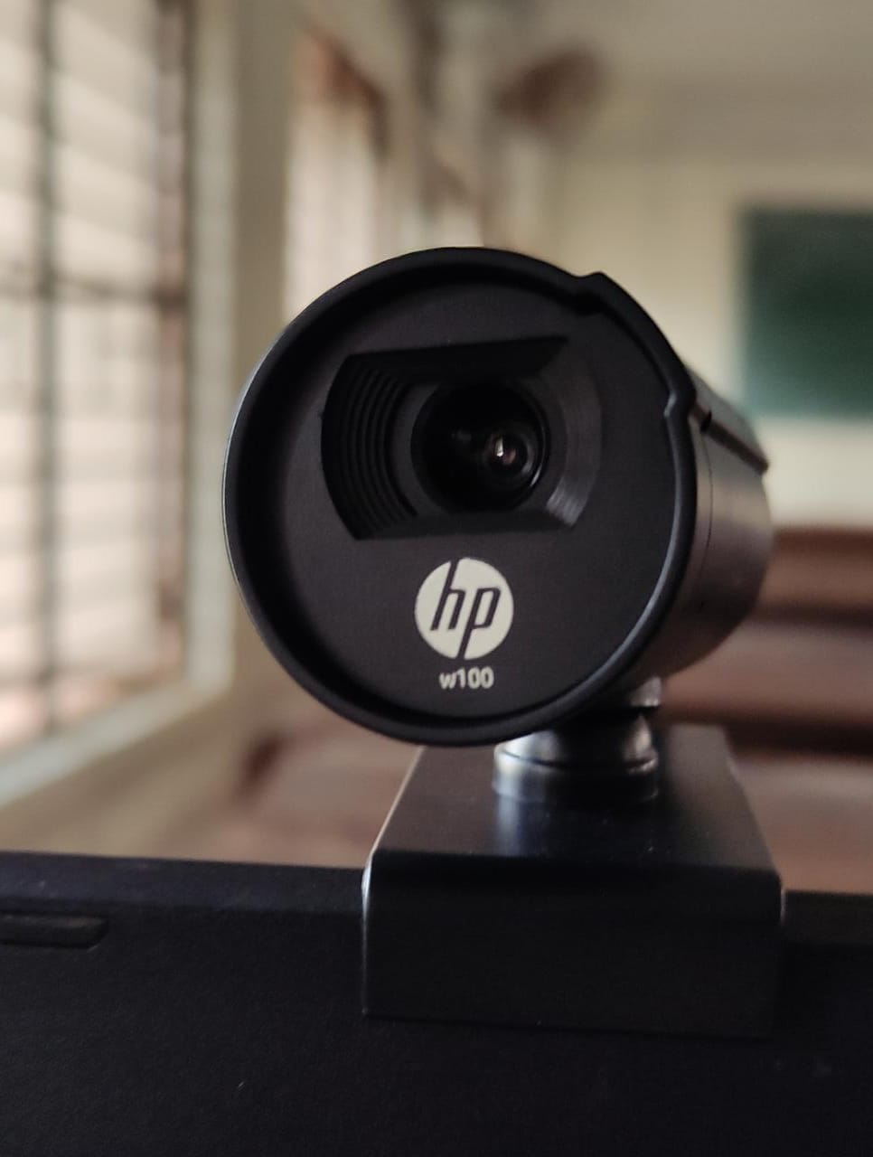
COMPONENTS
Fig 38. Webcam
Fig 37. Node MCU

Slide 69
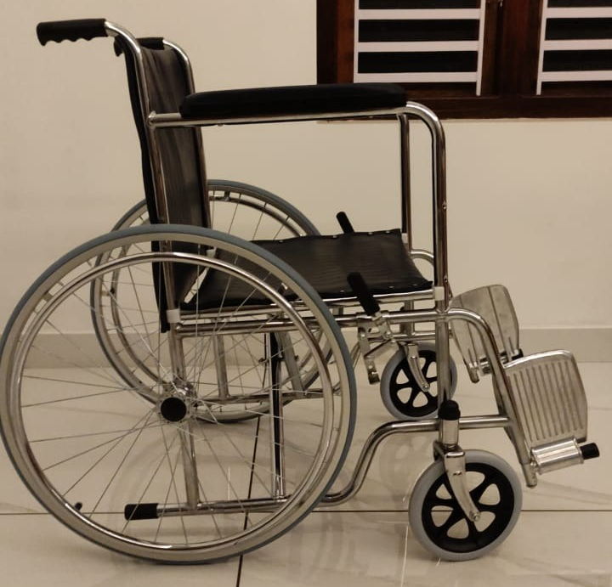
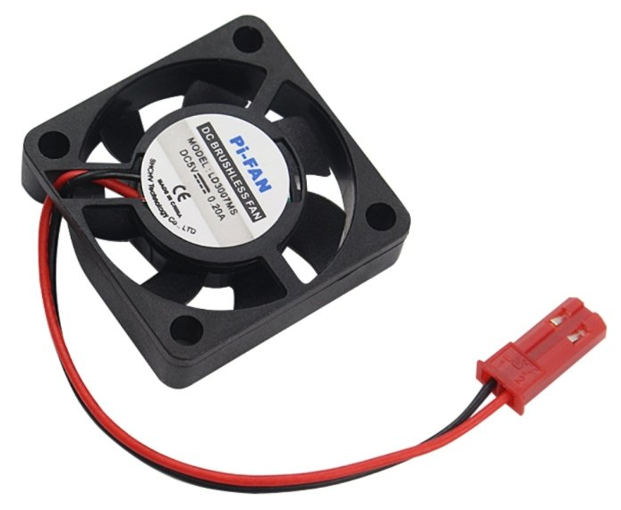
COMPONENTS
Fig 40. Cooling Fan
Fig 39. Node MCU

